Slide 1
Transforming steering controls to self driving
Final report
Hongshuo Wang
Professor Siu Ling Leung
Notes:
Hi this Hongshuo Wang. I’m person who in charge of object detection in self driving project. First, I would like to say thank you professor Leung offer me this great opportunity; Moreover, thank s my partners Kavan, Tommy, and Owen. Without their great jobs, our project could be done successfully.

Slide 2
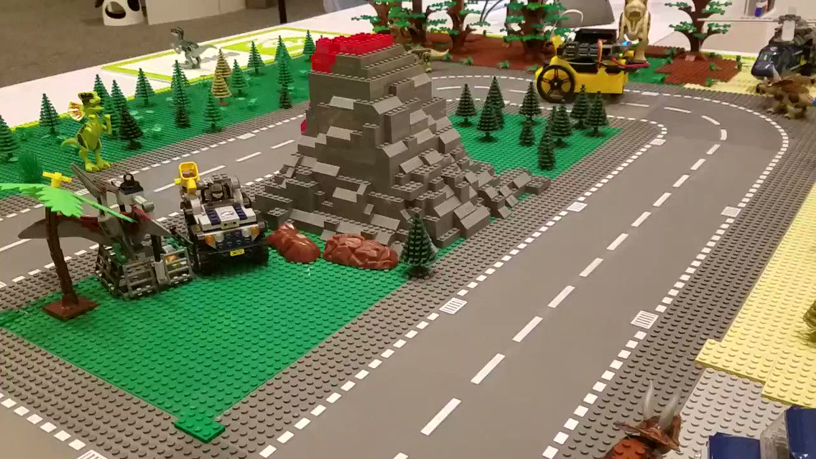
Project’s Goal: Object Detection Model on jetson nano
implement self-driving on a mini town
Notes:
Ok, let’s talk about what I done in this project. Besides the other memebers, my job is the further extension of self-driving. Again, just repeating our project goal is Transforming steering controls to self driving. We want using a extra steering wheel controller to drive our jetbot in a mini town and perform specific task when encounter a traffic signs. For example, when you see a stop sign, your car must stop a while or For no left turn sign, you car can only go straight forward or turn right etc. However, when the jetbot see multiple signs at the same time, the traditional classification model can only recognize one sign instead of several signs.

Slide 3
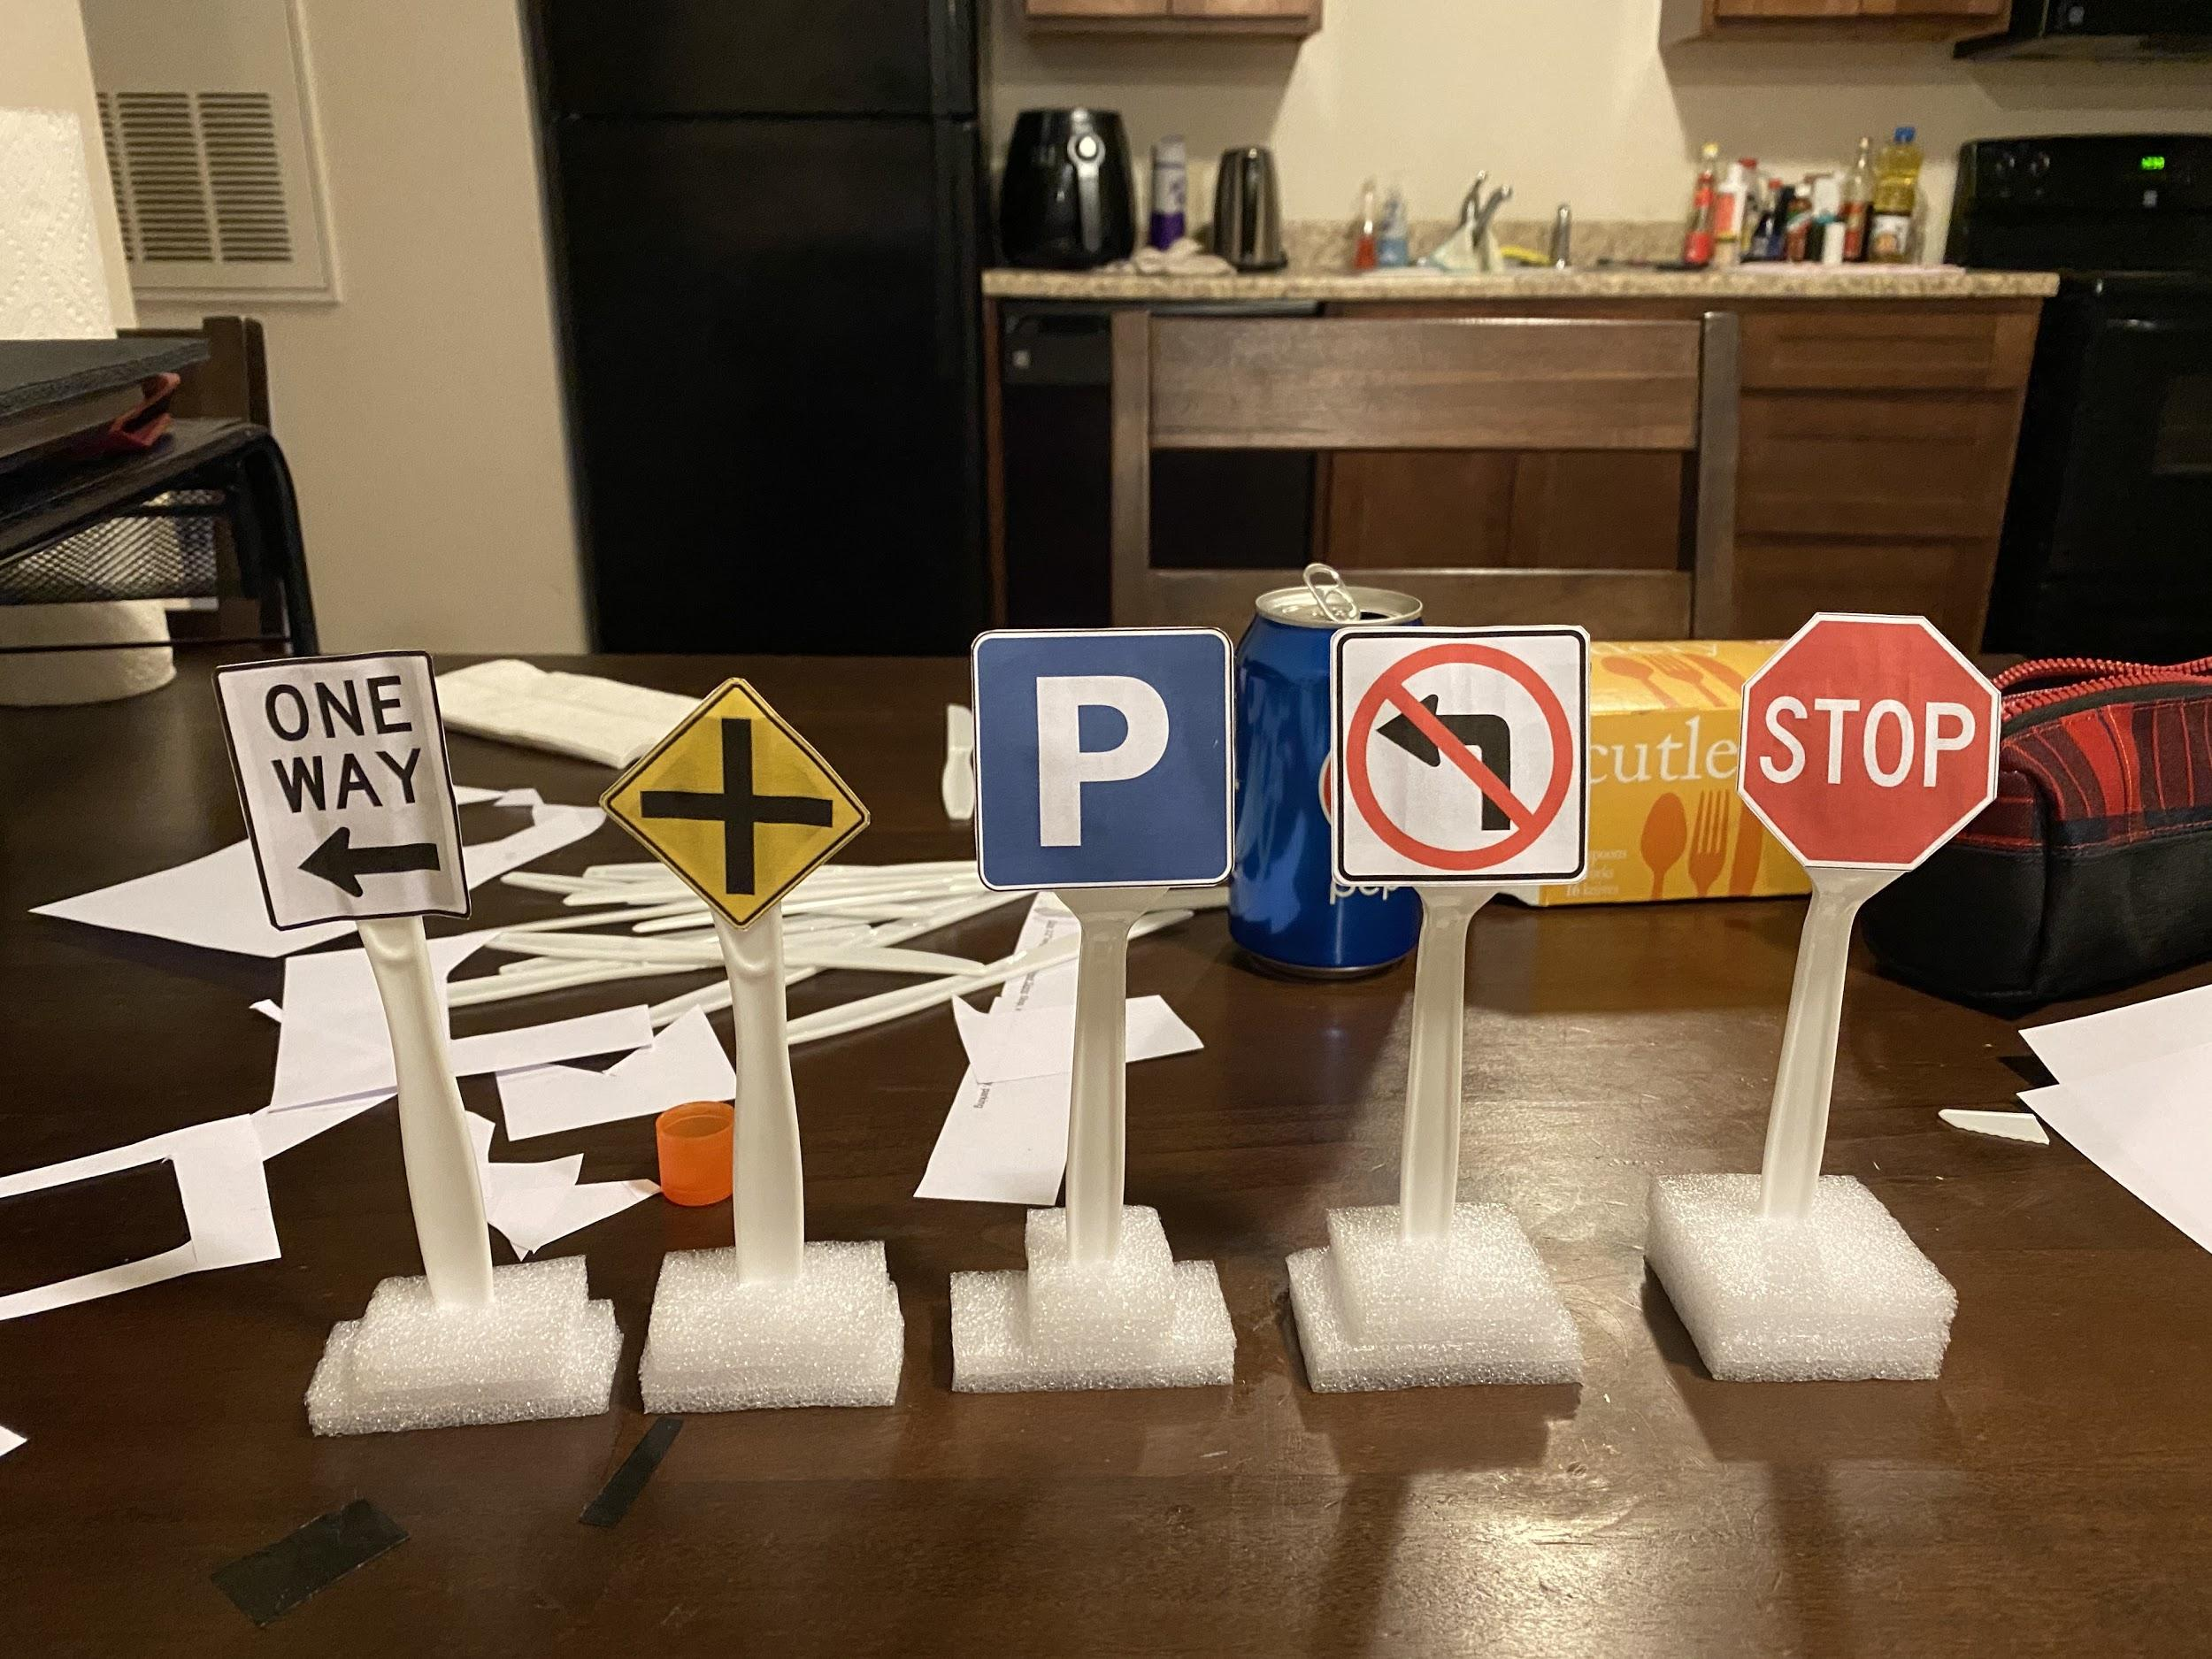
Object Detection Model on jetson nano
Using transfer learning to detect five traffic signs on Jetbot.
Below link is source images https://docs.google.com/document/d/1Jq9aE4flSdQxKx9lJPnDWctRR3kcz9WCzpDbJDQIonY/edit?usp=sharing
I will send my small signs with the jetbot. Free to check the size of traffic signs.

Slide 4
Progress:
Collecting data: Creating a dataset for five traffic signs
Selecting suitable model
Training the model
Evaluating the trained model on Jeson Nano
Improving the model
Notes:
Next, I’m going to talk about how I implement the object detection. Naturally, I decide to use transfer learning instead of training on the raw model due to the consideration of time saving and limited computing power.
What I lists in the slides are the five main steps I implement model.
Collecting data: Creating a dataset for five traffic signs
Selecting suitable model
Training the model
Evaluating the trained model on Jeson Nano
Improving the model

Slide 5
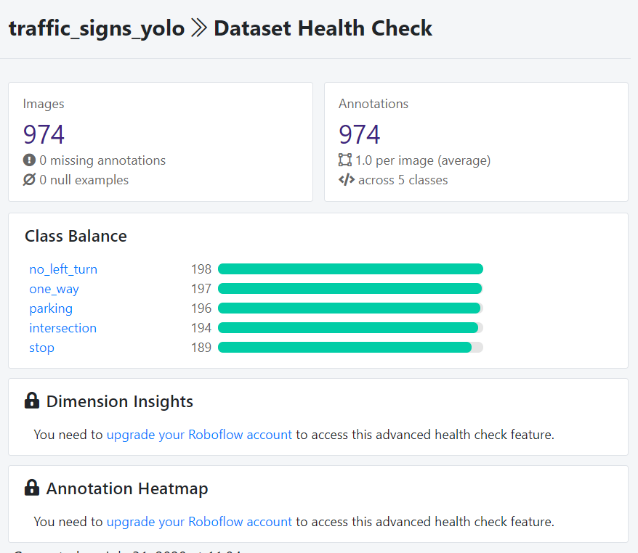
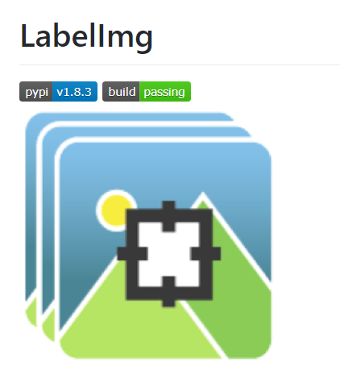
Collecting Data
Collect 974 in total 224 x 224 raw image by using jetbot camera
Use labelImg
Using Data Augmentation to enlarge our dataset to 2355 images
Notes:
First, collecting data. Thanks my partners Kavan and Tommy for helping collecting the data. Since our program is using the default jotbot camera as the input, we decided use jetbot camera to take the pictures. We took in about 200 images per class and about 1000 in total images. Then we use labelImg program to label objects. This open source program will output xml file which records the bound box and class types information for the corresponding images.
Then I import my labeled image(both jpg file and xml file) to roboflow program which will can do data augmentation and transfer your data into specific version satisfy different model needs. I did rotation, cropping and shearing on our input images and Finally enlarge our dataset to 2355 image in order to get a more robust model.

Slide 6
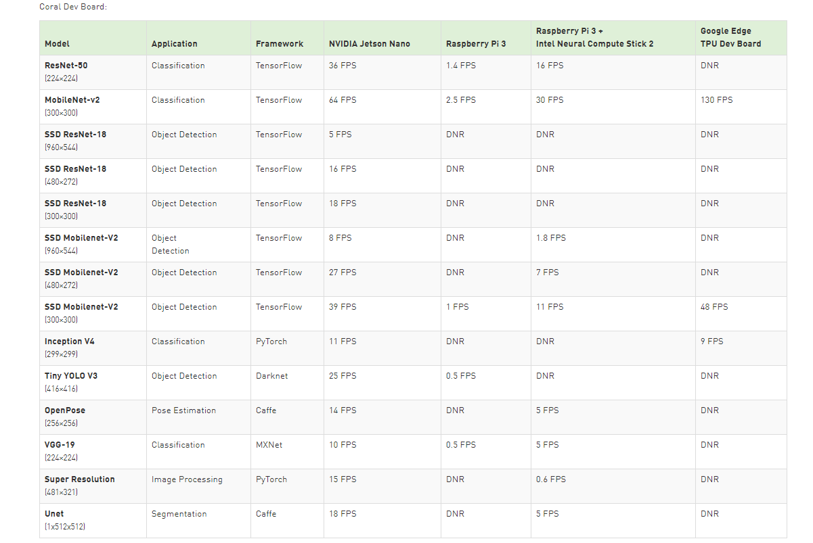
Selecting suitable model
Yolov3 vs SSDmobilev2 vs Yolov4
Notes:
Next, I need to decide which kinds of model. By doing researches and looking at the official Nvidia website, I pick three potential options: yolov3, ssdmobilev2 and yolov4. All of them are current popular model on mobile object detection.

Slide 7
Training the model
Using colab (roboflow ai)
ssdmobilev2 (tensorflow 12 hours)
Yolov3 darknet 6 hours
Yolov4 darknet 8 hours vs Yolov4-tiny-416 5 hours
Notes:
It almost took me three weeks to prepare the data , build the environment, train three model and finu tune it. I was firstly thinking to train the model on the jetbot but when I tested on jetbot, it runs extremely slow since jetbot got only 4 memory and limited gpu. In order to save time, I make most of colab by create several google accounts and trains all models on colab at the same time. These time I listed in the slides is the average time of took to train each model

Slide 8
Evaluating the trained model on Jeson Nano
Set up the environment:
tensorflow 1.15.2 object detection API
Pycuda
onnx == 1.14
Visualization:
github tensorrt_demos
Callback:
Yolov4 > yolov3 > ssdmobile
FPS:
SSdmobilev2 (about 15 FPS) > yolov4 tiny (10 FPS) > yolov4 (4 FPS) > yolov3 (2 FPS)
Notes:
Last, I want to combine my last two topics together. The biggest problem I faced after I trained each model and evulated on the jetbot is running speed. Because of the jetbot limited performance as I mentioned before, the model runs unafford slow at low FPS. When I look at the official guides of jetson nano, it suggests to complile our trained model into the engine file which speeds up the performance of the model on jetbot. Depending on the github module tensorrt_demos, I successfully build up the engine file, and compare the results’ parameter. I make some trade off between callbacks rate and FPS. And finally, I decide to pick yolov4 tiny model as my final model. You can see how well it performs in the demos slide. Thank for your watching.

Slide 9
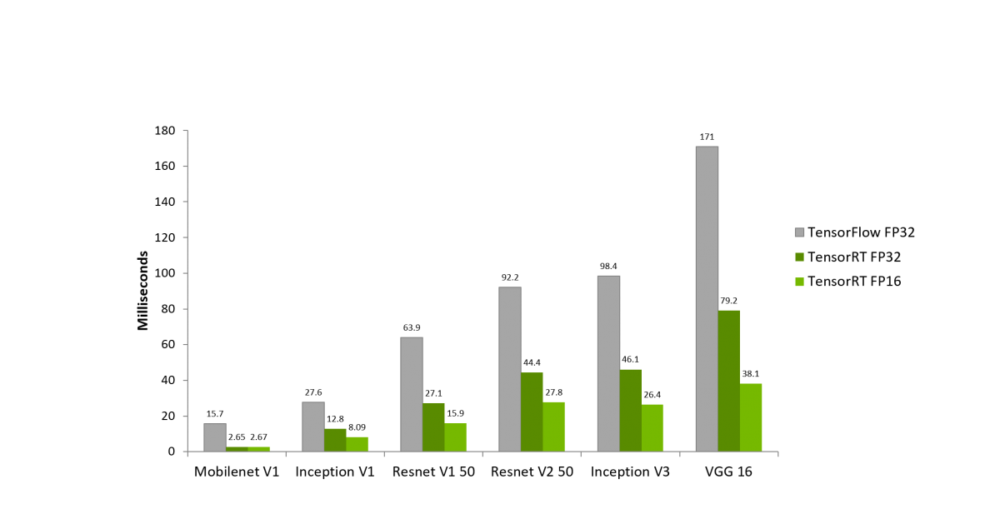
Improving the model
Transfer weight file to Nvidia engine file to speed up the speed
Install tensorrt 6.1
Create 8 GB swipe file in order to expand jetbot’s memory

Slide 10

Demos
Notes:
Thank for your watching

Slide 11
Reference
https://developer.nvidia.com/embedded/jetson-nano-dl-inference-benchmarks
https://app.roboflow.ai/dataset/traffic_signs_yolo/8
https://github.com/tzutalin/labelImg
https://github.com/jkjung-avt/tensorrt_demos
https://courses.nvidia.com/courses/course-v1:DLI+C-RX-02+V1/about
https://models.roboflow.ai/
https://github.com/jkjung-avt/tensorrt_demos/blob/master/ssd/build_engine.py
https://www.minds.ai/post/deploying-ssd-mobilenet-v2-on-the-nvidia-jetson-and-nano-platforms
https://blog.csdn.net/weixin_43046653/article/details/101106542?ops_request_misc=%257B%2522request%255Fid%2522%253A%2522159471945319195239845897%2522%252C%2522scm%2522%253A%252220140713.130102334.pc%255Fall.%2522%257D&request_id=159471945319195239845897&biz_id=0&utm_medium=distribute.pc_search_result.none-task-blog-2~all~first_rank_ecpm_v3~pc_rank_v3-2-101106542.pc_ecpm_v3_pc_rank_v3&utm_term=jetbot+nano+%E7%89%A9%E4%BD%93%E8%AF%86%E5%88%AB

Slide 12
Reference
https://github.com/AastaNV/TRT_object_detection
Object Detection with MobileNet-SSD slower than mentioned speed - Jetson & Embedded Systems / Jetson Nano - NVIDIA Developer Forums
dusty-nv/jetson-inference: Hello AI World guide to deploying deep-learning inference networks and deep vision primitives with TensorRT and NVIDIA Jetson.
How to Train YOLO v5 on a Custom Dataset - YouTube
[ASK] How to make tensor RT engine from frozen graph tensor flow? - Jetson & Embedded Systems / Jetson Nano - NVIDIA Developer Forums
Object Detection with MobileNet-SSD slower than mentioned speed - Jetson & Embedded Systems / Jetson Nano - NVIDIA Developer Forums

